Slide 1
Capstone -2 | Presentation
Police Fatality Prediction

Slide 2
Problem Identification
Police involved fatality needs to find better ways to predict the flee/not flee count in their fatality counts.
In this dataset over 12,000 fatality records were taken for this project.
We need to merge Population records for the EDA clarity.
Need to extract a numerical dataframe from the exist one.
We need to find correlation between Flee and other parameters.

Slide 3
Recommendation and key findings
The solution for the business problem was a general one of modeling to predict flee /not flee .
Using our Random forest classifier model to gain insight into what police fatality’s flee count could be, and how that might change under various scenarios.
Using hot coding to interpret categorical data into numerical one.
The original dataset was imbalanced one.
Using undersampling and oversampling to balance the dataset.
Using Auroc curve to visualize the prediction

Slide 4
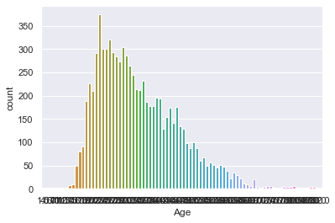
Modeling Fatality prediction –Flee count / Age

Slide 5
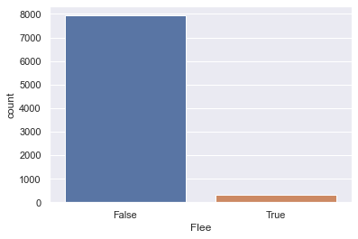
Fatality prediction –Flee count – True/False

Slide 6
Imbalanced / Initial result
Random Forrest Accuracy: 96.0
Mean Absoulte Error: 4.0
Classification Report:
precision recall f1-score support
0 0.96 1.00 0.98 1937
1 0.62 0.06 0.10 90
accuracy 0.96 2027
macro avg 0.79 0.53 0.54 2027
weighted avg 0.94 0.96 0.94 2027
Confusion Matrix:
predicted
0 1
actual 0 1934 3
1 85 5

Slide 7
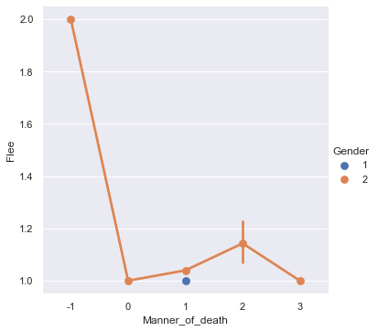
Fatality by Police –Flee prediction /Gender

Slide 8
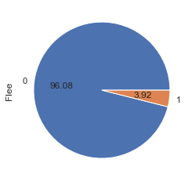
Fatality by Police –Flee count – original dataset

Slide 9
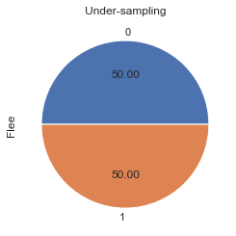
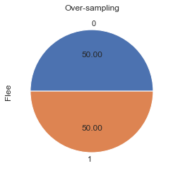
Fatality by Police –undersampling|oversampling

Slide 10
Balanced / Final Result / Under Sampling
* Random Forrest Accuracy: 74.0
Mean Absoulte Error: 26.0
Classification Report:
precision recall f1-score support
0 0.70 0.76 0.73 75
1 0.77 0.71 0.74 84
accuracy 0.74 159
macro avg 0.74 0.74 0.74 159
weighted avg 0.74 0.74 0.74 159
Confusion Matrix:
predicted
0 1
actual 0 57 18
1 24 60

Slide 11
Balanced / Final Result / Over Sampling
Random Forrest Accuracy: 94.0
Mean Absoulte Error: 6.0
Classification Report:
precision recall f1-score support
0 1.00 0.88 0.94 1928
1 0.90 1.00 0.94 1966
accuracy 0.94 3894
macro avg 0.95 0.94 0.94 3894
weighted avg 0.95 0.94 0.94 3894
Confusion Matrix:
predicted
0 1
actual 0 1700 228
1 8 1958

Slide 12
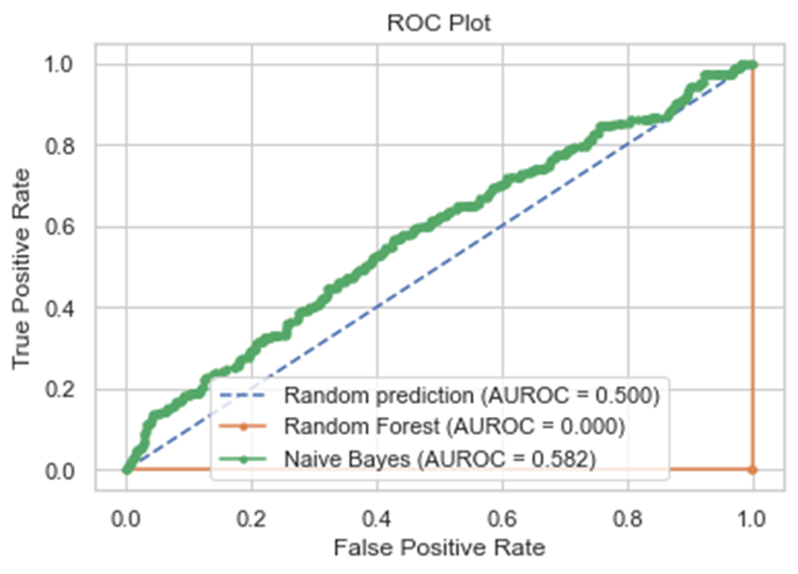
Fatality by Police | AUROC curve | Flee prediction

Slide 13
Summary and Conclusion
The solution for the business problem was a general one of random forest classifier modeling to predict flee /not flee .
Using our Random forest classifier model to gain insight into what police fatality’s flee count could be, and how that might change under various scenarios.
Using hot coding to interpret categorical data into numerical one.
The original dataset was imbalanced one.
Using undersampling and oversampling to balance the dataset.
Using Auroc curve to visualize the prediction

